Slide 1


DA-NAT4 - Group 2
DATA ANALYTICS PROGRAM
INTERIM PROJECT
Pearl Asare
Elsheikh Ibrahim
Dawit Atreso
Hamza Ibrahim
Abdulrahman Rajjoub
Alice Venables
SUPERVISOR: Randell Maree

Slide 2
Introduction and Topics
Regional Sales in Best Performing Country
Relationship between sick leave vs Job Title
Relationship between Total Leave Hours vs Bonus
Store Trading Duration vs Revenue
Relationship between Country and Revenue
Relationship between Size of Stores, Employee Count and Revenue

Slide 3
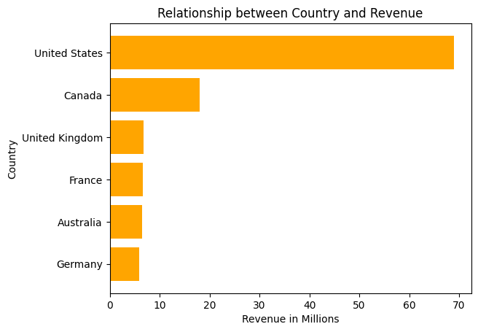
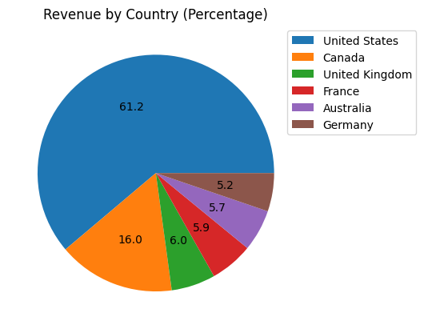
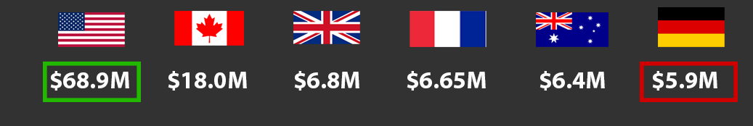
Relationship between Country and Revenue
Countries with stronger economic conditions tends to generate more revenue.
Countries contributing low revenue might reflect smaller markets.

Slide 4
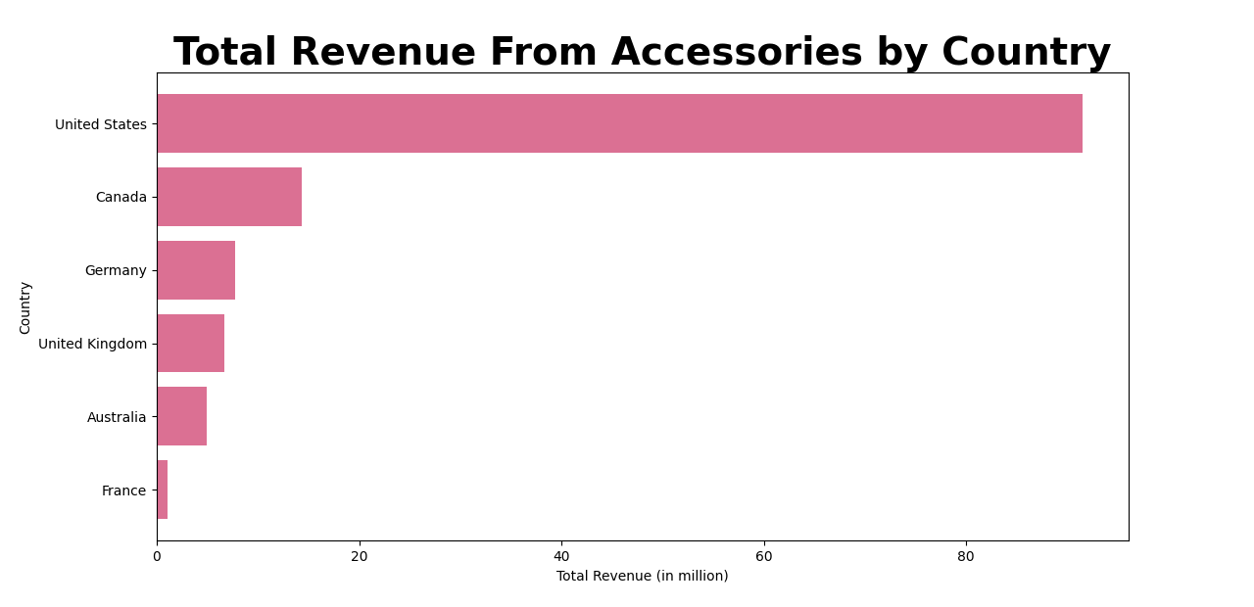
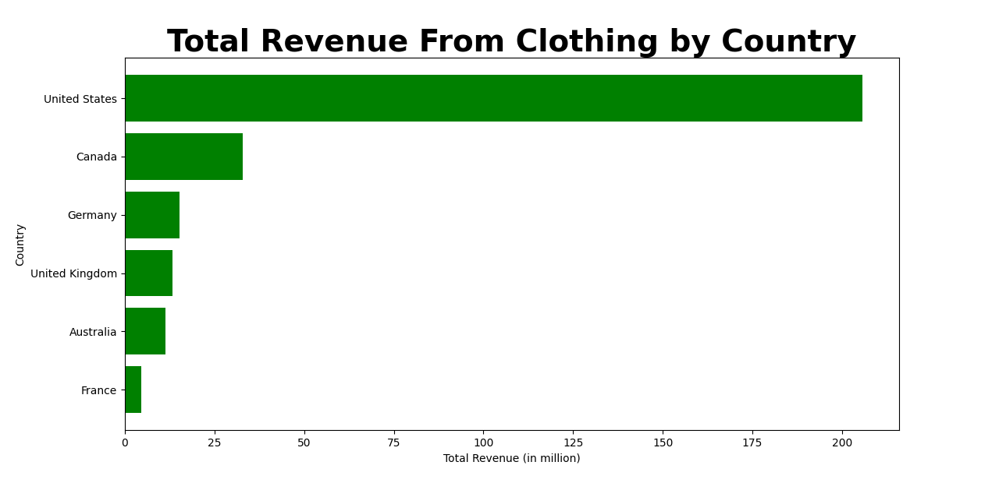
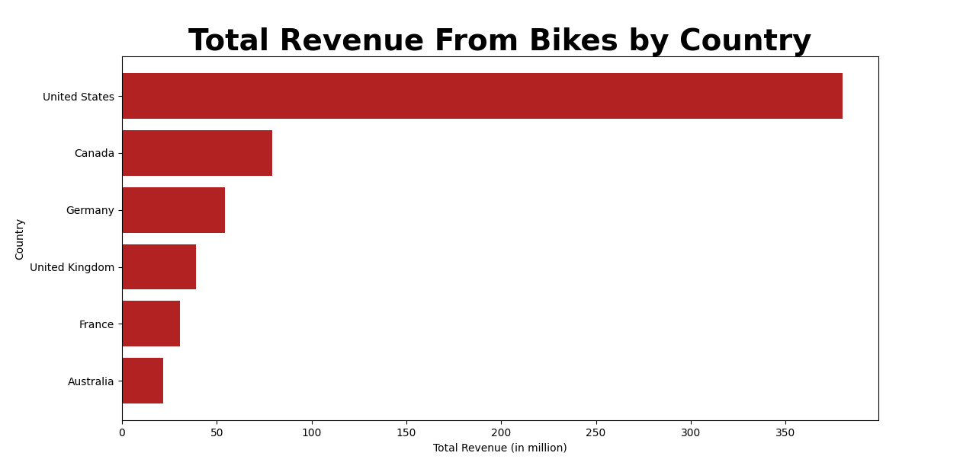
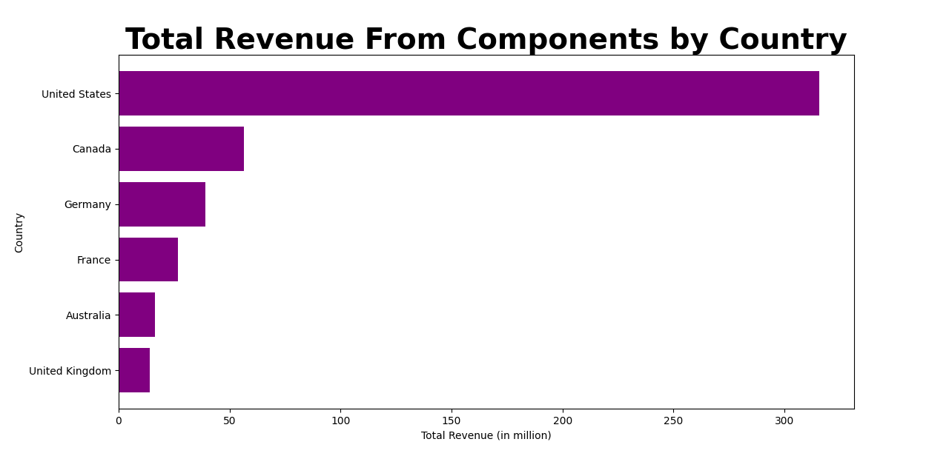
Relationship between Country and Revenue

Slide 5
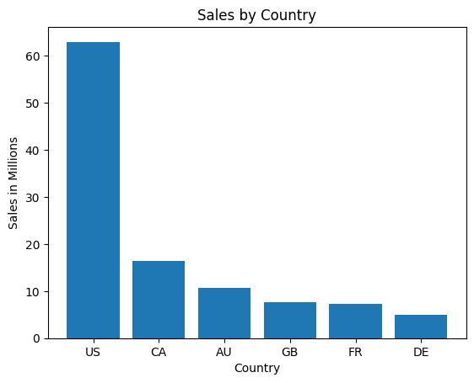
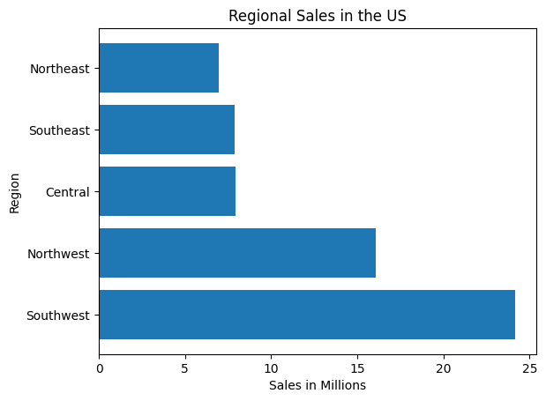
Regional Sales in Best Performing Country
The Southwest is the leading region

Slide 6
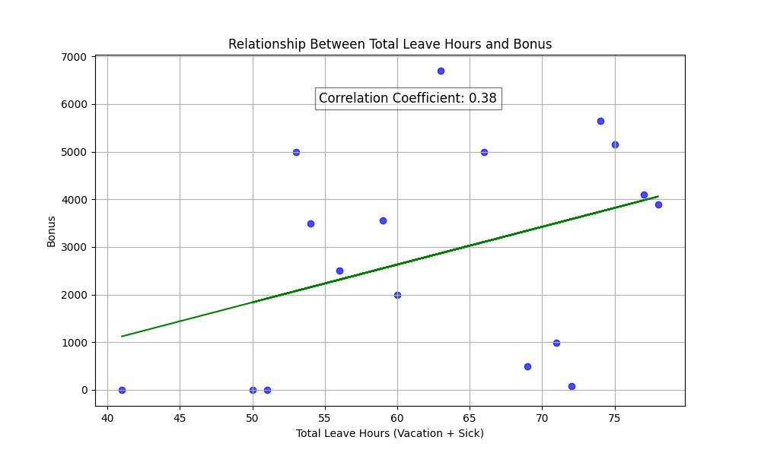
Relationship Between Total Leave Hours and Bonus
0.38 signifies a weak to moderate relationship
Could other factors be the cause of increase ?
Notes:
Relationship Between Total Leave Hours and Bonus
The scatter plot shows a weak positive correlation (0.38) between total leave hours (vacation + sick) and bonuses. Key points from the analysis:
Weak Positive Correlation: As leave hours increase, bonuses tend to rise slightly, but the relationship is not strong.
Data Spread: The data points are scattered, indicating variability, with some points deviating significantly from the trend line.
Outliers: A few outliers show bonuses much higher or lower than expected based on leave hours.
Practical Implications: While leave hours may have some impact on bonuses, other factors like performance, tenure, and role are likely more influential. The data shows correlation, not causation.

Slide 7
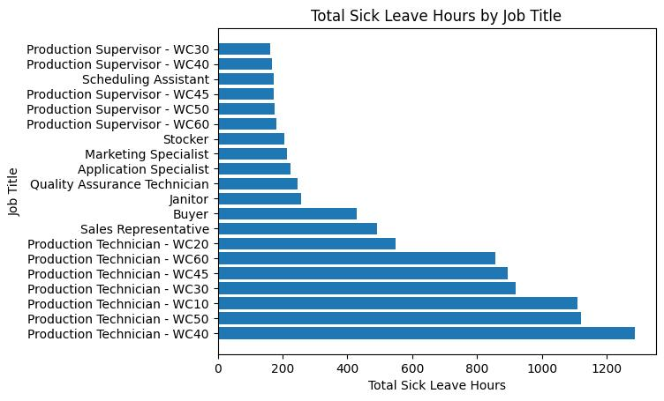
Relationship Between Sick Leave and Job Title?

Slide 8
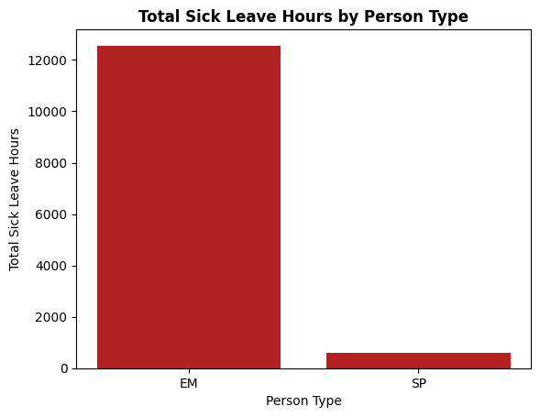
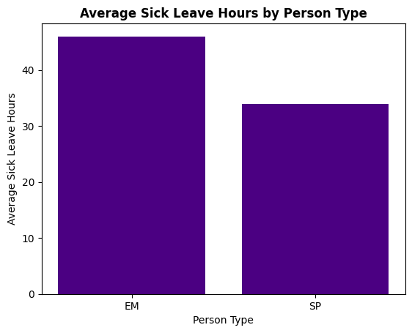
Relationship Between Sick Leave and PersonType?
Key Findings:
Employees (EM) Tends to Have Higher Sick Leave Hours
Sales Persons (SP) in other hand have less Sick Leave Hours

Slide 9
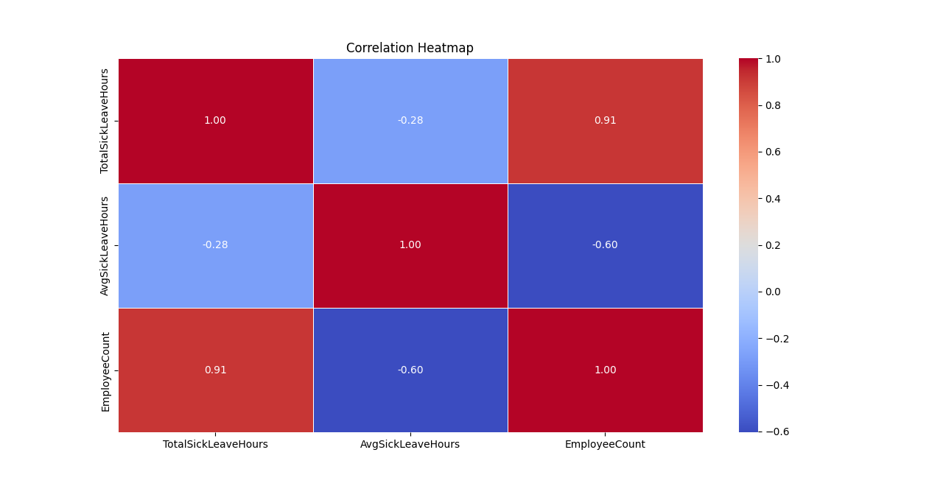
The Correlation between Total Sick Leave Hours, Average Sick Leave Hours, and Employee Count?

Slide 10
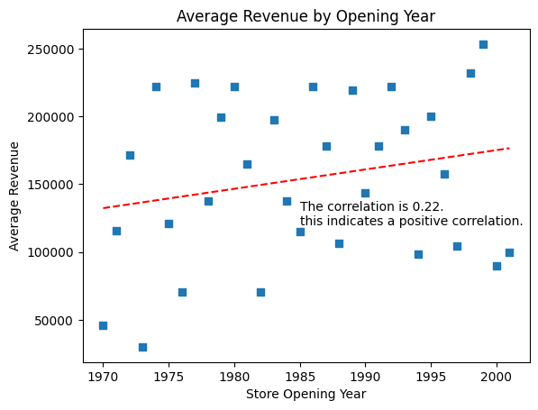
Store Trading Duration vs Revenue
Newer Stores Are More Profitable!
11%
Why Are They?

Slide 11
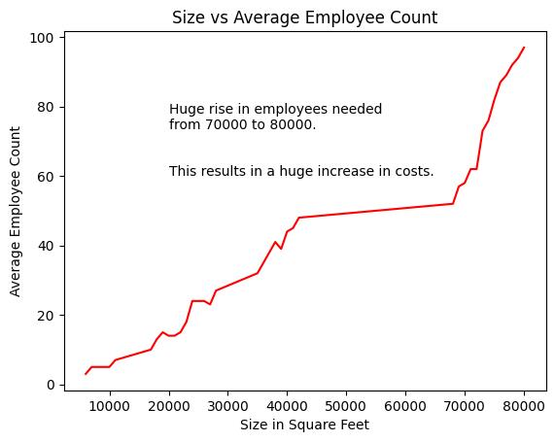
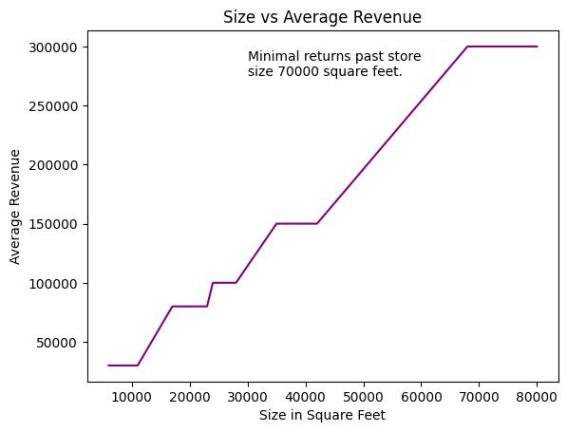
Size, Revenue and Number of Employees
Is Bigger Always Better?

Slide 12
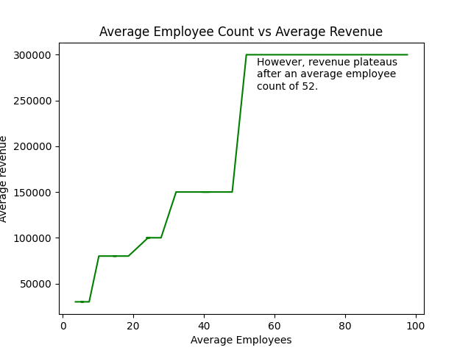
Average Employee Count vs. Average Revenue
Proper Staffing Means Proper Profits!
Too many staff is bad for business!

Slide 13
Conclusion
US Best Seller
But Not All Equal
More Leave
More Bonuses
More Employees
Means Less Sick Leave
New Stores
More Profitable
Bigger Is
Sometimes Better
Proper Staffing
Proper Profits

Slide 14


REFERENCES
atresodawit19@gmail.com
pearlasare@gmail.com
ibrahimhamza927@gmail.com
Rajjoubabdulrahman@gmail.com
AliceV@genstudents.org
eibra3@hotmail.com
https://www.linkedin.com/in/abdulrahman-rajjoub-a01690238/
/https://www.linkedin.com/in/dawit-atreso
linkedin.com/in/hamza-ibrahim-500220200

Slide 15
THANK YOU !!
"Why do programmers prefer dark mode? Because light attracts bugs!!"

